Slide 2

Alexander Walther
Physical Geographer
Ph.D. student
climatology
Acknowl. supervisors:
Prof. Deliang Chen, Hans Linderholm
Notes:
2
Background: geographer (strength & weakness: we know “a bit” about everything), geographers, describe the earth and phenomena on it (both physical and anthropogenic ones), what are the patterns and why, how are they linked
How does it look in space?
tasks: research, teaching, projects, science communication
Like to speak to students and kids to keep “feet on the ground” (communicate knowledge and science)

Slide 3
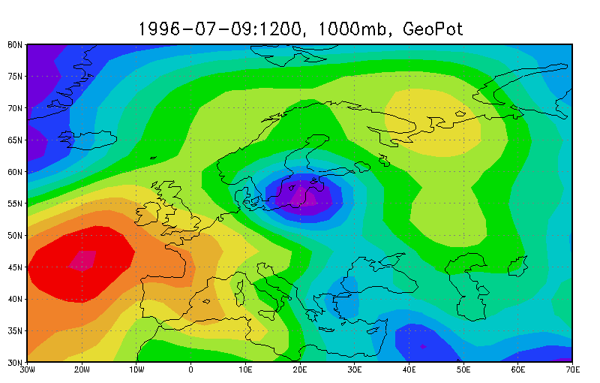
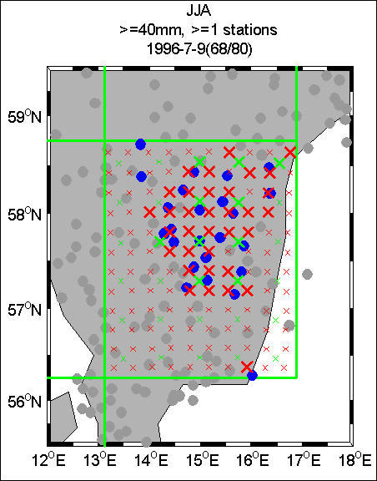
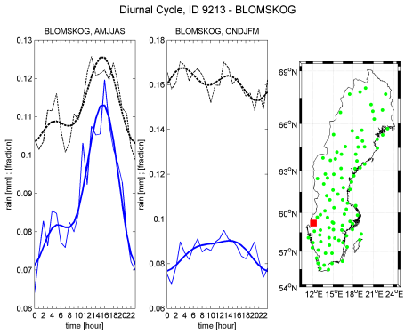
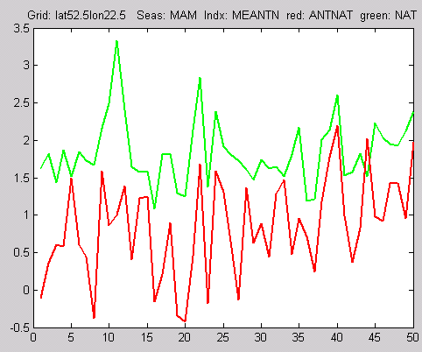
Research topics
Climate extremes (Temperature and precipitation) in past/present/future
links to atmospheric circulation
the role played by anthropogenic forcings
Sweden and Europe

Slide 4
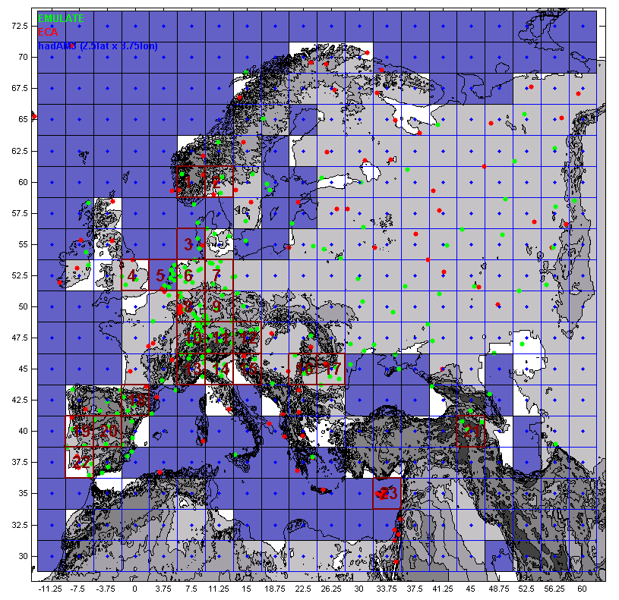
Observations ...
precipitation
temperatures
daily
hourly
point measurements with some spatial autocorrelation
... and models
precipitation
temperatures
...
daily, hourly, 10-min?
grid averages

Slide 5
Diurnal variation in precipitation amount and frequency in Sweden
Current work
Precipitation data in a mountainous catchment in Honduras: quality assessment and spatiotemporal characteristics
Westerberg et al. (accepted)
Thermal Growing Season (GSL)
Walther & Linderholm (2006), Linderholm et al. (2008), Song et al. (2009)
Trend Atlas of EMULATE extremes
Chen et al. (2006)
http://rcg.gvc.gu.se/data

Slide 6
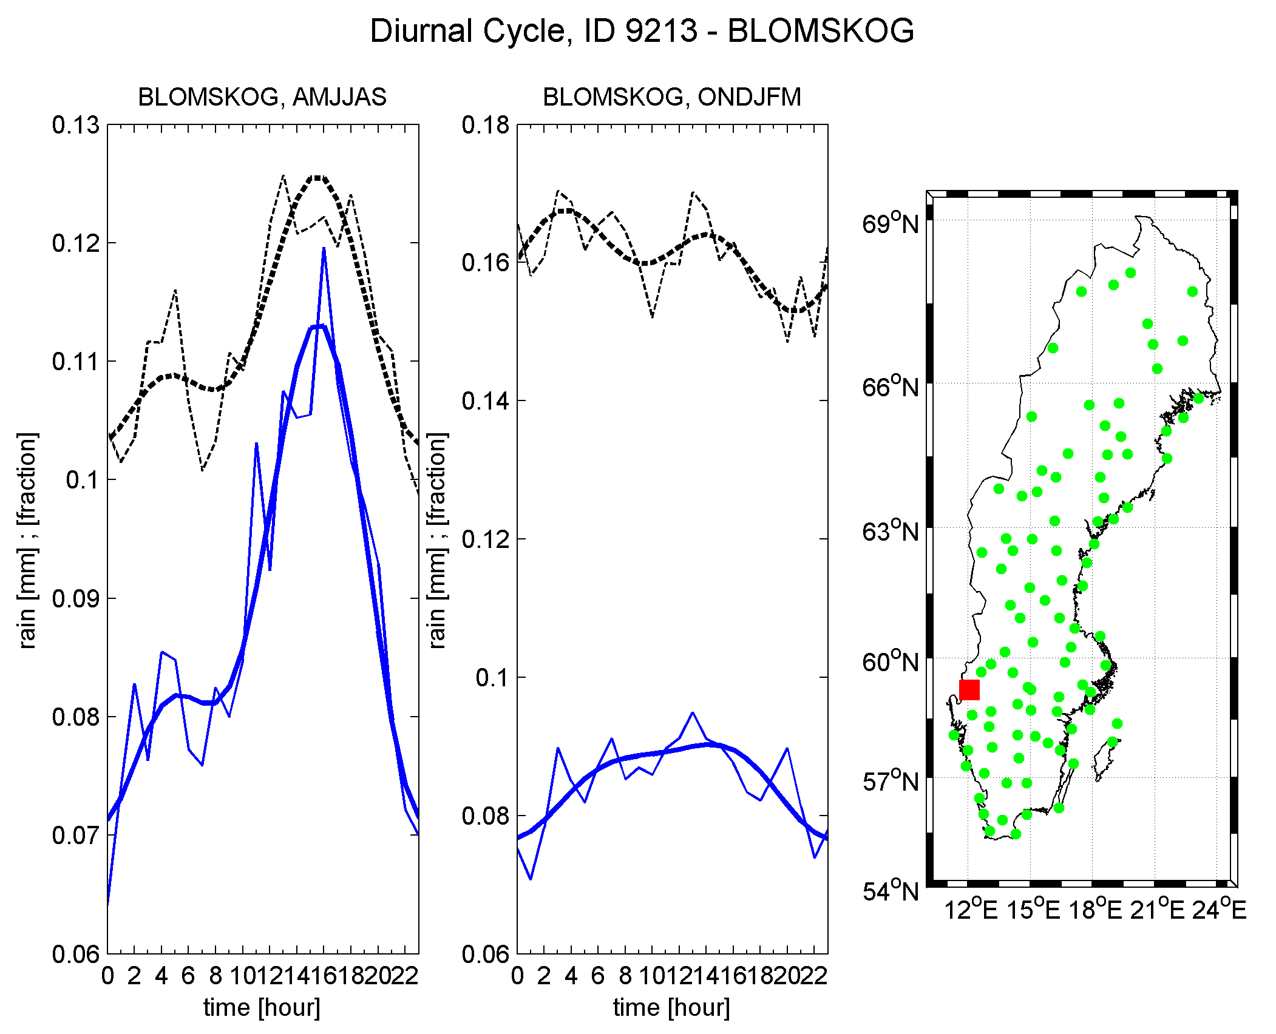
Diurnal variation in precipitation amount and frequency in Sweden

Slide 7
observations model

Slide 8
Spatial scale of extreme precipitation

Slide 9
 | GCM |  | 44km |  | 22km
min # of stations Prec | 1 | 5 | 1 | 5 | 1 | 5
40mm | 0 | 0 | 21 | 81 | 55 | 100
25mm | 1 | 5 | 27 | 90 | 70 | 98
10mm | 7 | 14 | 56 | 91 | 85 | 99.9
5mm | 22 | 34 | 74 | 97 | 93 | 100
2mm | 45 | 58 | 86 | 99 | 96 | 100
Cases [%] where interpolated rainfall matches observed rainfall

Slide 10

Twentieth-century trends in the thermal growing season in the Greater Baltic Area
GBA Average
(1951-2000)
-6.3 days
+1.1 days
+7.4 days
Start
End
Length

Slide 11
Trend atlas of the EMULATE indices
(Chen et al., 2006)
http://rcg.gvc.gu.se

Slide 12
+
-
+
-
+
-
+
-
Tmin
Tmax
Tmin/Tmax indices. Fraction of positive, positive significant, negative, and negative significant trends for 1901-2000. The areas showing the highest fractions for each index and season are colored.
percentiles
cold
warm
cold
warm
cold

Slide 13
+
-
+
-
+
-
+
-
Prec indices: Fraction of positive, positive significant, negative, and negative significant trends for 1901-2000. The areas showing the highest fractions for each index and season are colored.

Slide 14
Ongoing and planned
atmospheric circulation mechanisms behind extreme precipitation events
When does it rain and why
How will precipitation patterns (extremes, diurnal cycle) evolve in the future
Do anthropogenic forcing plays a role

Slide 15
Research topics
Climate extremes (Temperature and precipitation) in past/present/future
links to atmospheric circulation
the role played by anthropogenic forcings
Sweden and Europe

