Slide 1

Thermohaline structure, processes responsible for its formation and variation in the Gulf of Finland
Taavi Liblik
Marine Systems Institute at Tallinn University of Technology
Supervisor: Urmas Lips

Slide 2
Publications and plans
Lips, U; Lips, I; Liblik, T; Elken, J. Estuarine transport versus vertical movement and mixing of water masses in the Gulf of Finland (Baltic Sea). US/EU-Baltic Symposium "Ocean Observations, Ecosystem-Based Management & Forecasting", Tallinn, 27-29 May, 2008. IEEE, 2008, (IEEE Conference Proceedings), 1 - 8. Published.
Lips, I; Lips, U; Liblik, T. Consequences of coastal upwelling events on physical and chemical patterns in the central Gulf of Finland (Baltic Sea). Continental Shelf Research. Accepted.
In preparation
Kuvaldina, N; Lips, I; Lips, U; Liblik, T. The influence of a coastal upwelling event to the spatio-temporal distribution of nutrients and chlorophyll a in the Gulf of Finland, Baltic Sea: observational results. Submitted to Hydrobiologia.
Lips, U; Lips, I; Kuvaldina, N; Liblik, T. Sub-surface chlorophyll maxima in the Gulf of Finland.
Liblik, T; Lips, U. Characteristics of salinity and temperature fine structure in the Gulf of Finland in summer.
Liblik, T; Lips, U. Spreading of suspended matter in shallow sea area influenced by dredging activities and variable wind forcing: results of in-situ measurements.
Collecting data
Liblik, T, U. Lips. High-frequency variability of vertical temperature and salinity distribution in the central Gulf of Finland.

Slide 3
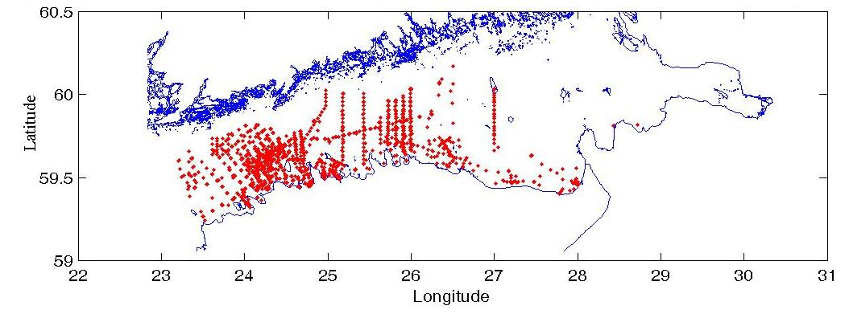
Characteristics of salinity and temperature fine structure in the Gulf of Finland in summer
Data
Based on data of 2143 CTD casts collected in 1987-2008
Higher number of CTD casts was available in the western and southern part of the Gulf
The CTD data have been processed and stored as vertical profiles with a resolution of 0.5 m
Different number of casts has been used in various analyses. The depth of casts used for analysis was at least:
  In the upper mixed layer (UML) analysis− 40 m;
  Thermocline and cold intermediate layer (CIL)− 60 m;
  Halocline− 80 m.

Slide 4
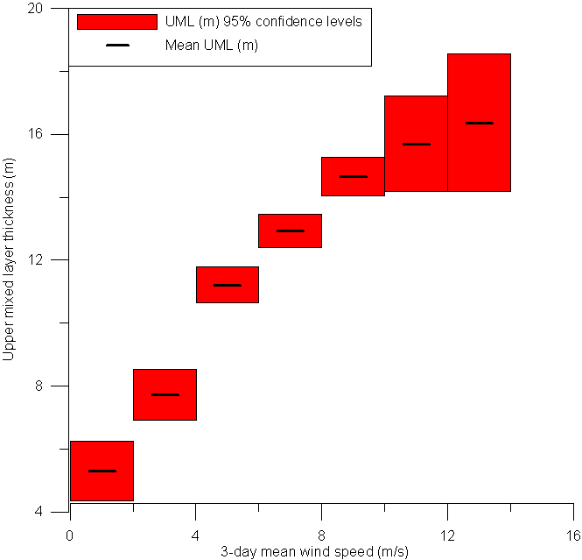
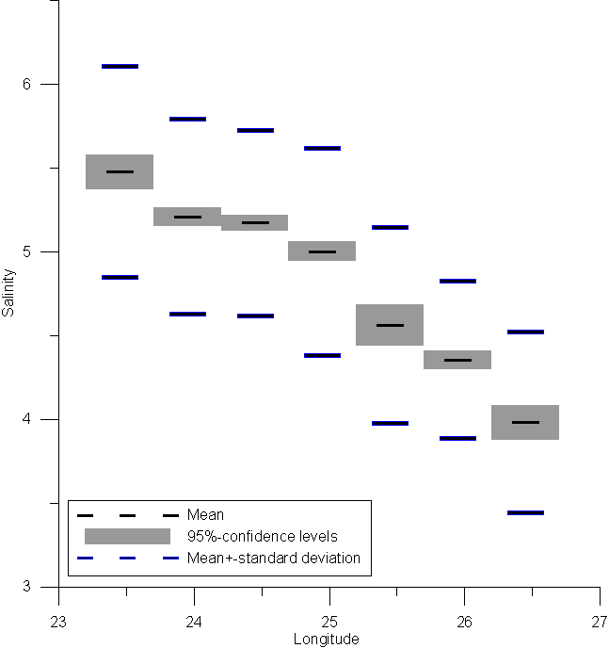
Characteristics of salinity and temperature fine structure in the Gulf of Finland in summer
Upper layer
A rough comparision between wind speed and UML showed a best correlation between the 3-day (a day when CTD cast was performed and 2 days before it) mean wind speed and the calculated mixed layer thickness.
The mean salinity distribution in the surface layer (0-5 m) is characterized by an increase from 4 in the central part of Gulf (26.2-26.7° E) to 5.5 in the mouth of Gulf. The mean salinity gradient is slightest between longitudes 23.7-24.7
The UML depth as a function of 3-day mean wind speed.
Changes of the mean surface layer salinity along the gulf.

Slide 5
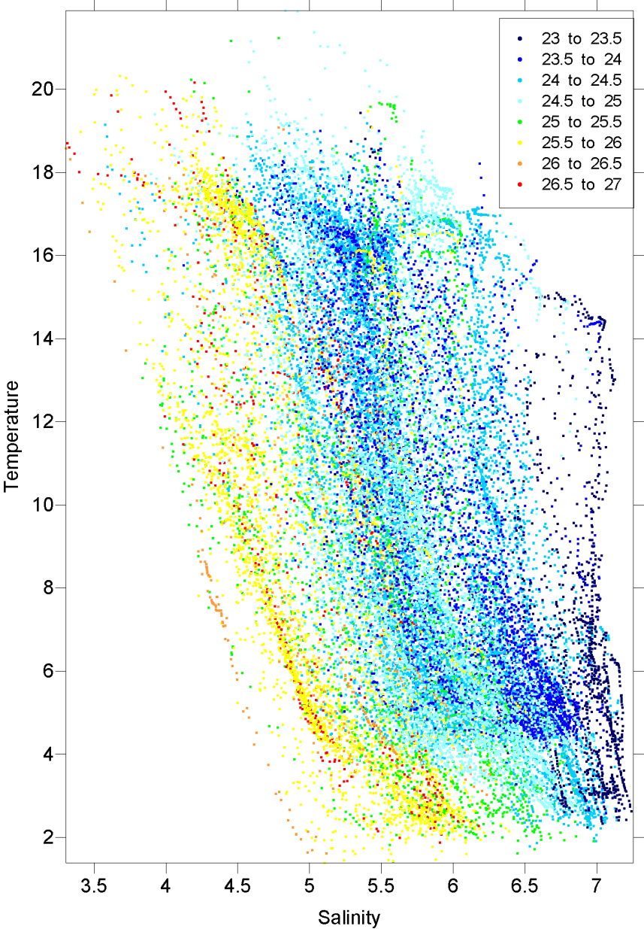
Characteristics of salinity and temperature fine structure in the Gulf of Finland in summer
Longitudes
Thermocline
The temperature in thermocline is decreasing mostly 0-1.5 °C m⁻¹ (76 % of cases) and salinity is increasing 0-0.2 m⁻¹ (71 % of cases).
Mean vertical temperature gradient in the thermocline was 1.10 °C m⁻¹ and salinity gradient 0.11 m⁻¹.
The steepest temperature gradient in thermocline was most probably situated in range 12-21 m (52 %).
The steepest temperature gradients in each profile were most frequently (76 %) in range 1...5 °C m⁻¹ (0.5-meter vertical step was used in calculation).
Also some gradients more than 10 °C/m were registered but steepest gradients than 8 °C/m are in general quite rare. Such gradients just 4-5% of casts can be found.

Slide 6
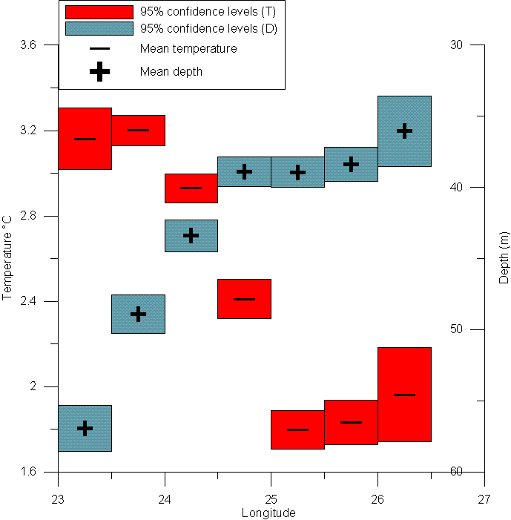
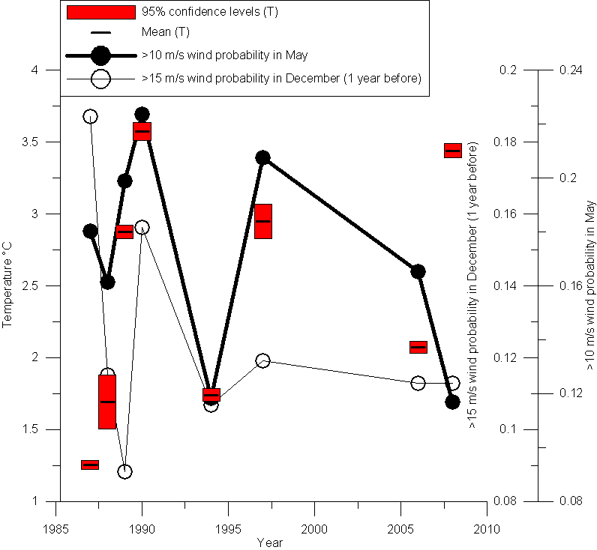
Characteristics of salinity and temperature fine structure in the Gulf of Finland in summer
Cold intermediate layer
Cold intermediate layer properties mostly depend on mixing conditions, especially in winter and spring, when the vertical density gradient is smaller and mixing in water can be done with less energy.
The mean temperature of the coldest point of temperature profile is approximately 3.2 °C in the western part of gulf (23-24° E) and 1,7-2 °C in the eastern part of gulf (25-26.5° E).
In the depth of coldest point of profile similar along the Gulf gradient exists.
Probabilities of occurrence of wind speed ≥10 ms⁻¹ in May and corresponding interannual variability of CIL temperature were in a quite good conformance. Exceptional years were 1987 and 2008.

Slide 7
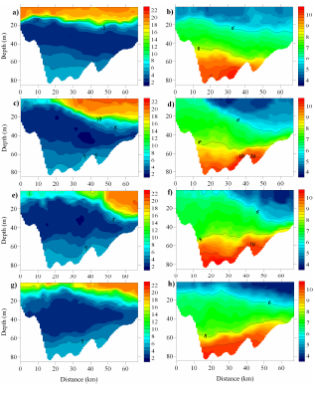
Consequences of coastal upwelling events on physical and chemical patterns in the central Gulf of Finland.
The off-shore extent of upwelling of 20 km and > 30 km a week later as well as its coupling with the downwelling along the opposite coast was documented
TS-analysis of profiles obtained before and during the upwelling event suggests that while welled up the cold intermediate water was mixed with the water from the upper mixed layer with a share of 85% to 15%.
Taking into account a characteristic along-shore extension of the upwelling of 200 km, the phosphate-phosphorus amount is approximately equal to the average total monthly riverine load of phosphorus to the Gulf of Finland.
25.07
T
S
08.08
15.08
22.08

Slide 8
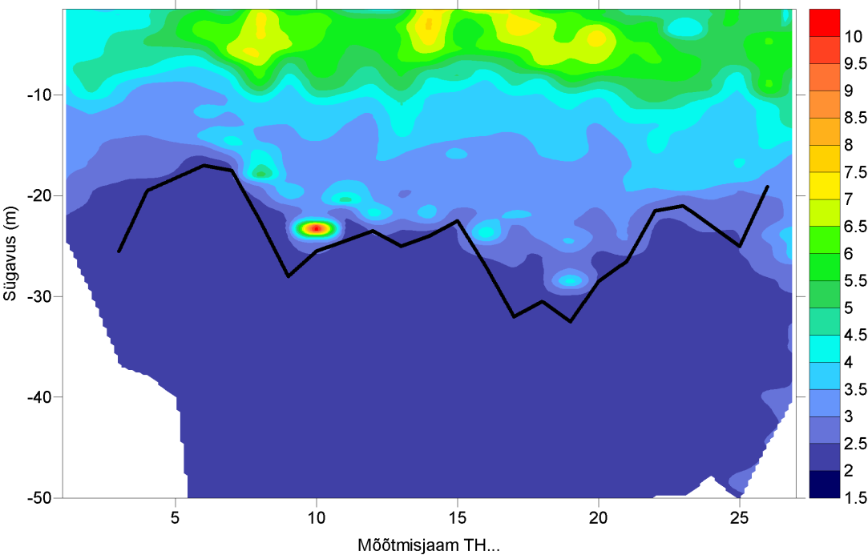
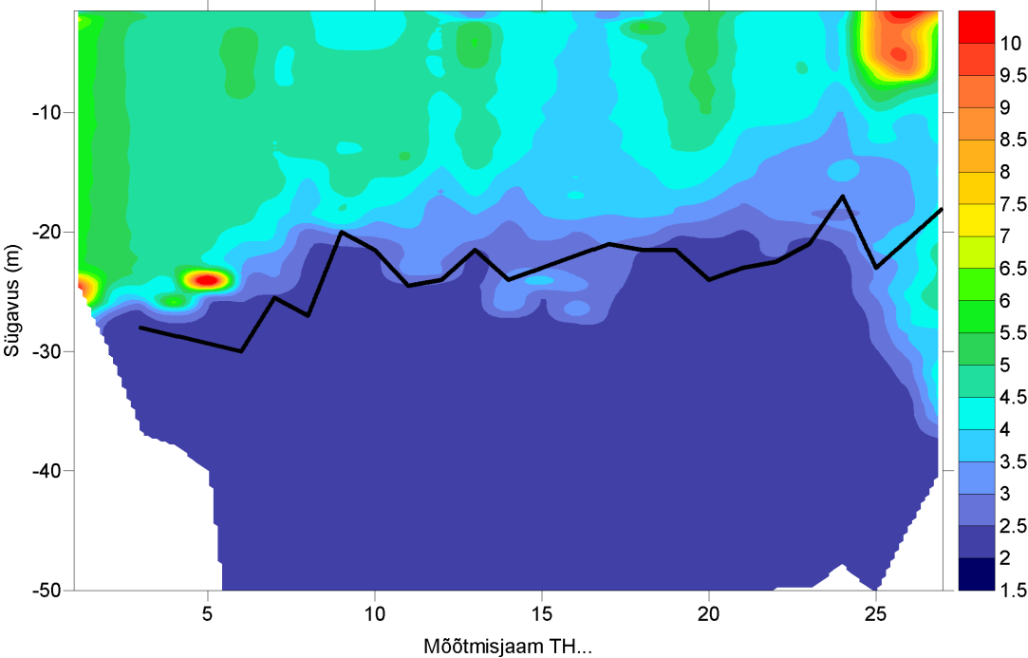
Sub-surface chlorophyll maxima in the Gulf of Finland
Tallinn
Helsinki
Tallinn
Helsinki
11.07.2006
18.07.2006

Slide 9
Sub-surface chlorophyll maxima in the Gulf of Finland
28.07.2009

Slide 10
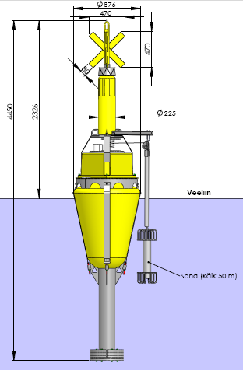
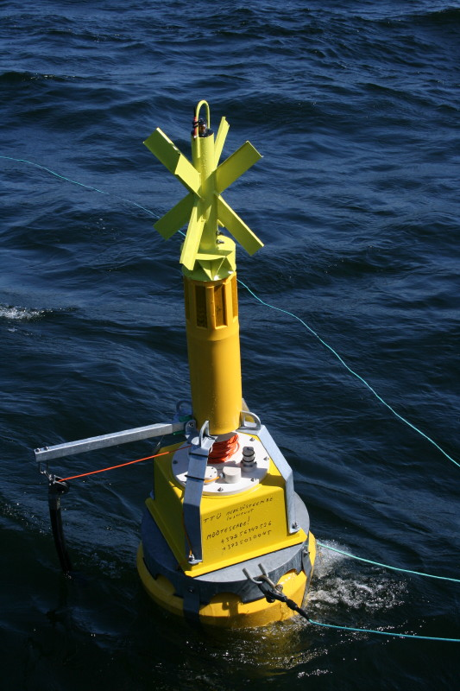
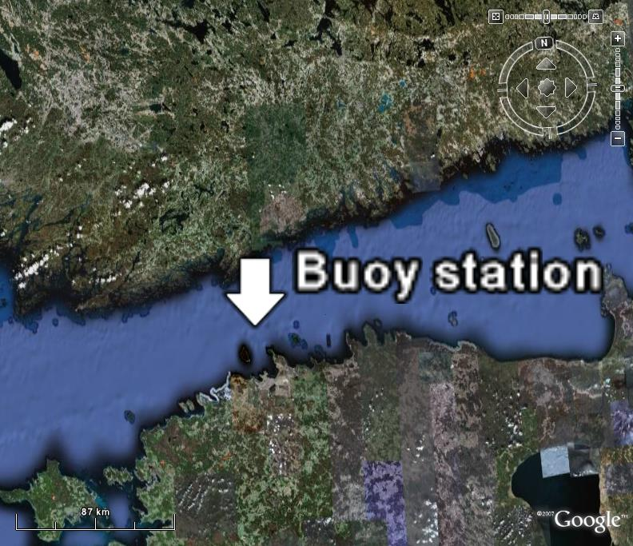
High-frequency variability of vertical temperature and salinity distribution in the central Gulf of Finland.
Temperature, conductivity, pressure, fluorescence sensors
Depth ~85 m
Profiling depth 50 m
Profiling speed 10 cm/s
Measuring frequency 10 Hz

Slide 11
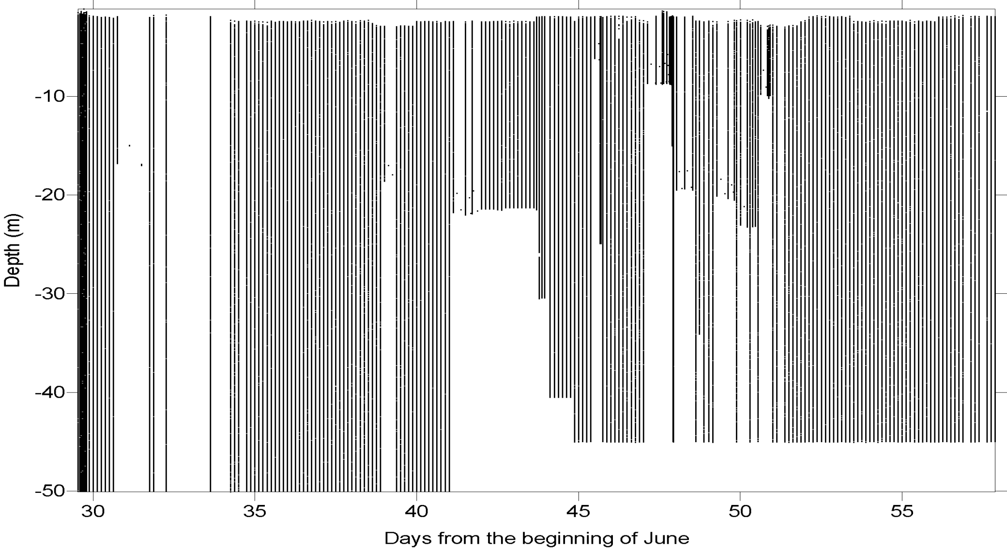
High-frequency variability of vertical temperature and salinity distribution in the central Gulf of Finland.
Data

Slide 12
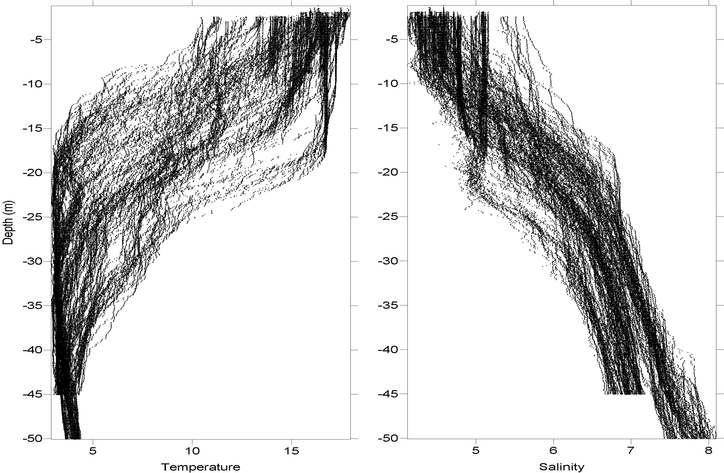
High-frequency variability of vertical temperature and salinity distribution in the central Gulf of Finland.

Slide 13
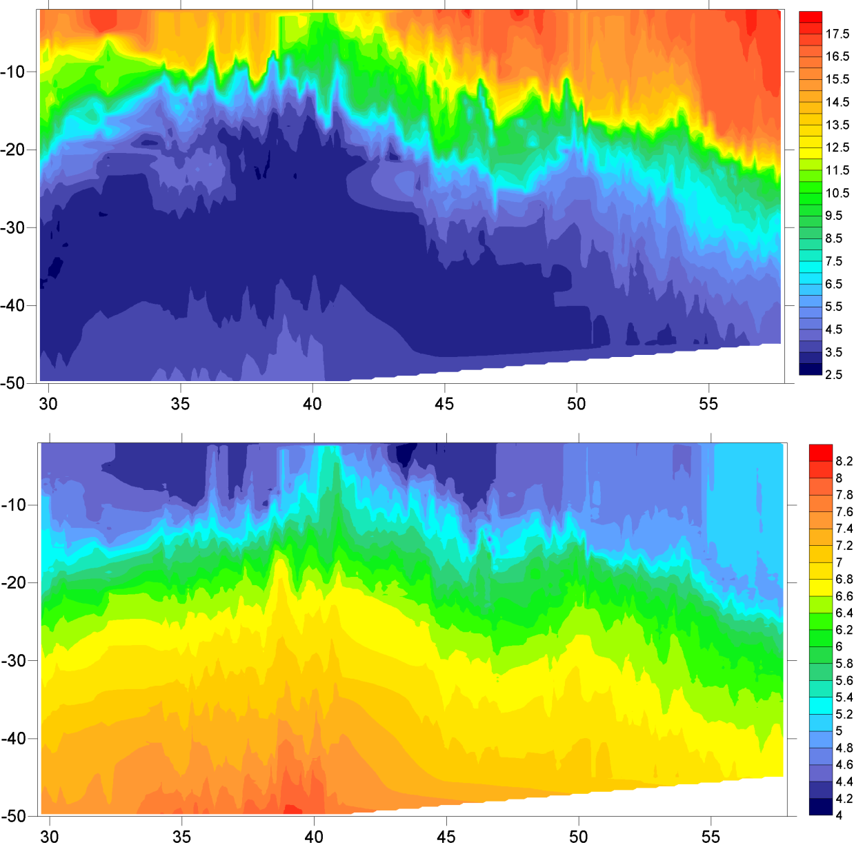
High-frequency variability of vertical temperature and salinity distribution in the central Gulf of Finland.
T
Depth
S
Days from the beginning of June
13:00, 30.06.2009
21:00, 28.07.2009

Slide 14
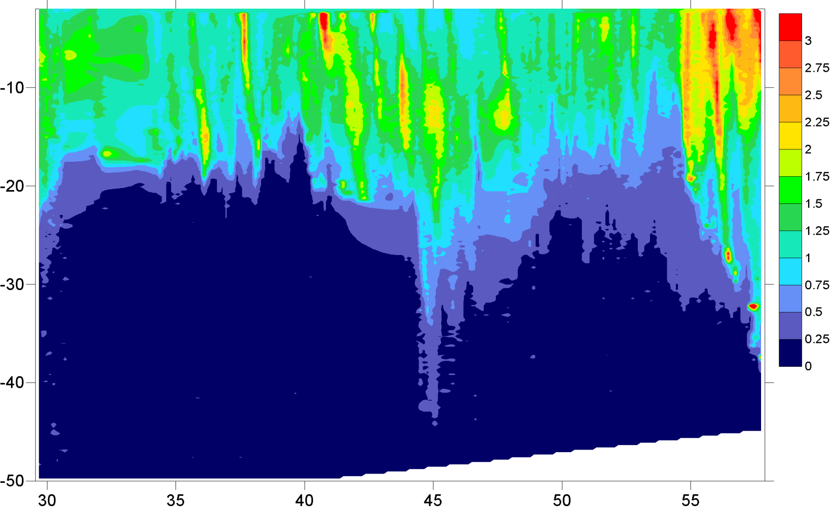
High-frequency variability of vertical temperature and salinity distribution in the central Gulf of Finland.
Fl
Depth
Days from the beginning of June
13:00, 30.06.2009
21:00, 28.07.2009

Slide 15
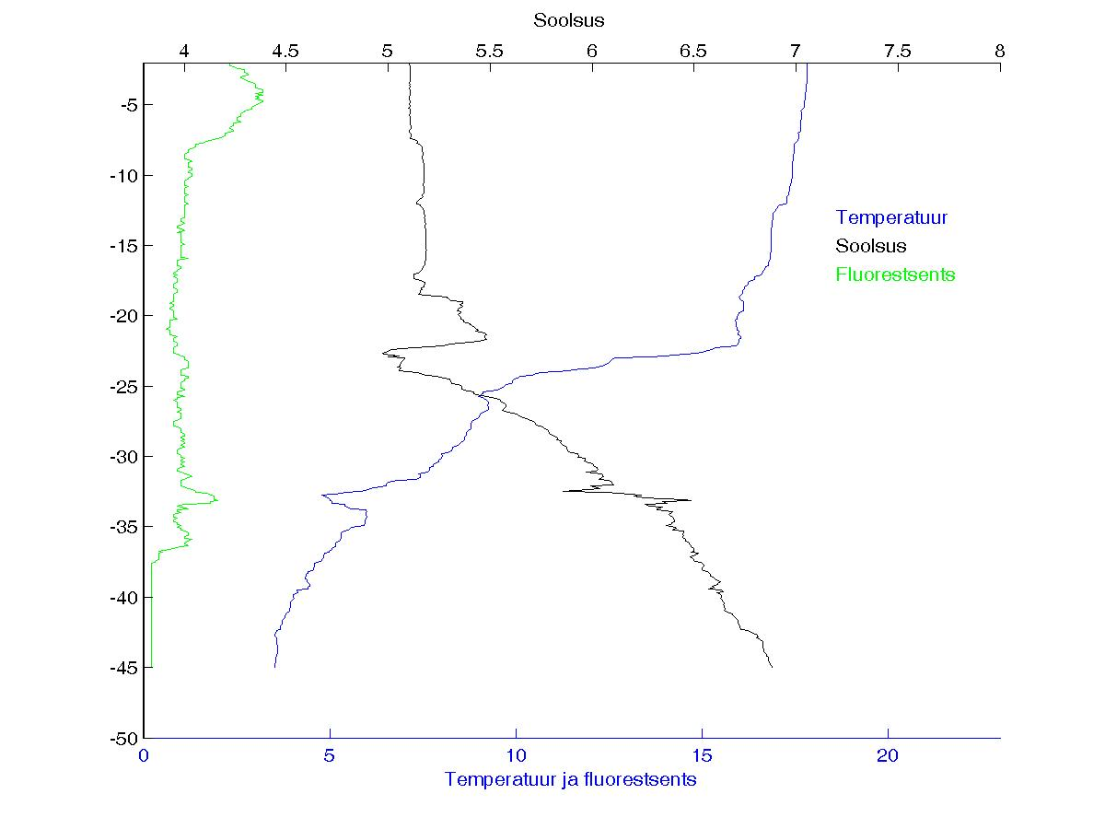
Thank You
Temperature
Salinity
Fluoroscence
Today 15:00

