Slide 1
Effects of Ocean Acidification on Keystone Species of the Baltic Ecosystem
Elin Renborg
DEPT. OF MARINE ECOLOGY - TJÄRNÖ
UNIVERSITY OF GOTHENBURG

Slide 2

Advanced tool for scenarios of the Baltic Sea ECOsystem to SUPPORT decision making
objectives: to model the combined effects of changing climate and changing human activity on the greater Baltic ecosystem and provide an advanced modeling tool for scenario simulations that can underpin management strategies.
Source: http://www.baltex-research.eu/ecosupport/

Slide 3
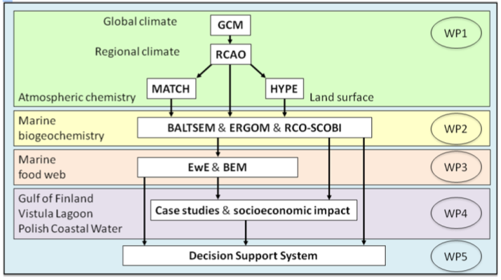
Model hierarchy in ECOSUPPORT
Assessments of possible effects of OA on key processes and species in the BS ecosystem
http://www.baltex-research.eu/ecosupport/

Slide 4
Background: Ocean Acidification
the average concentration of CO₂ in the atmosphere has increased by more than a third since preindustrial time, ~1750 (Candell et al.,2007)
oceans have absorbed nearly a third of the anthropogenic CO₂ released under the last 200 years. (Sabine et al., 2004)
pH of the surface oceans has declined by 0.1 units in average since pre-industrial time which is about 30% increase in hydrogen ions (Raven et al., 2005)
CO₂ + H₂O = H₂CO₃
H₂CO₃ = H⁺ + HCO₃⁻
CO₃²⁻ + H⁺ = HCO₃

Slide 5
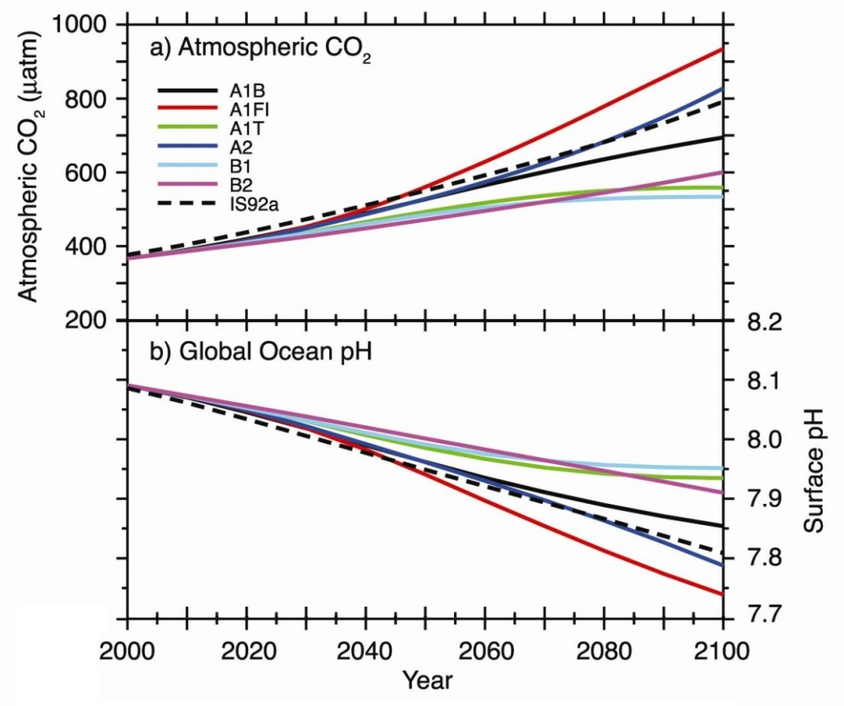
Future Scenarios
IPCC-report 2007, Orr et al., 2005

Slide 6
Biological impacts
direct effects:
calcification CaCO₃ ↔ Ca⁺ + CO₃⁻
other physiological processes
reproduction and early life stages
indirect effects:
population size
species distribution
community structure

Slide 7
Model Species: Mytilus edulis
oceanic waters to brackish eustaries
link between pelagic and benthic ecosystems
sperm and eggs are released directly into the water column
pelagic larvae

Slide 8
Sperm motility and Fertilization
Hypotheses:
A 0,4 unit reduction in seawater pH (being likely to
occur until 2100)
H₀1: will not affect sperm motility
(% motility and swimming speed)
H₀2: will not affect fertilization success
(% cleaving embryos)
of Mytilus edulis

