Slide 1
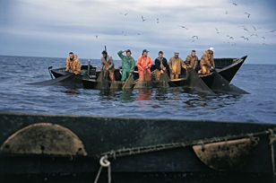
Spatial modeling of climate change induced impacts on German Coastal Fisheries
Eva Papaioannou
Christian Albrechts University of Kiel
Department of Geography
Cluster of Excellence ‘Future Ocean’
Coastal Risks and Sea-Level Rise RG
© IFREMER

Slide 2
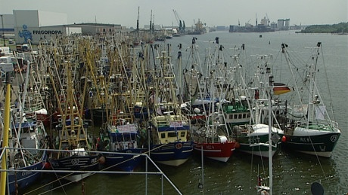
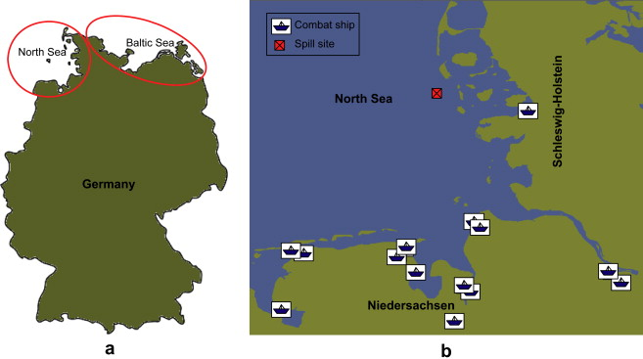

German Fishery Sector
Primarily Cutter/coastal fisheries (vessels’ number, % employment)
Coastal fisheries: North Sea, Baltic

Slide 3
Scope of Research / Aims-Objectives
1. Scenario modeling of climate change
How will oceanographic variables and ‘fishery habitats’ change with changing climate?
2. Simulation of climate change induced impacts on fishery resource - Use of spatially explicit fisheries’ bio-economic models
What are the anticipated trends in population dynamics and fleet dynamics? (SPATIAL SIMULATION)
3. Assessment/Adaptation of models’ implicit spatial framework
Can the spatial framework of the models be improved?

Slide 4
1. Selection of suitable oceanographic variables
(Climate Change simulation)
North Sea: Sea Surface Temperature / Baltic: SST, Salinity, O₂
Net Primary Production
‘Fish habitats’
Bathymetry
(Data acquisition: BSH, German Hydrographic Institution)
2. Formulation of Regional Coastal Fishery Database
Species composition
With respect to oceanographic indices /
Fish habitats
Species distribution
(Data acquisition: Federal/Local Ministries, ICES, HELCOM, etc)
3. Climate Change Scenario Modeling
Oceanographic variables: Values SRES (IPCC) / Regional climate models
Time scale: Offset year 2050
Notes:
SRES Special Report on Emission Scenarios (4 storylines)

Slide 5
4. Modeling of climate change impacts on coastal fishery
Multi-species assessment (e.g. predator-prey)
Population dynamics
How will species’ composition change with changing climate?
Will new species enter the system?
Additional considerations: Impact on species’ reproductive capacity and food availability (primary production)
Fleet dynamics
Landings (€)
% employment of workforce in local area
Reduction in number of vessels, catches
Ownership composition of the fleet
(Social indices !)

Slide 6
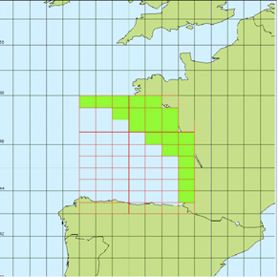
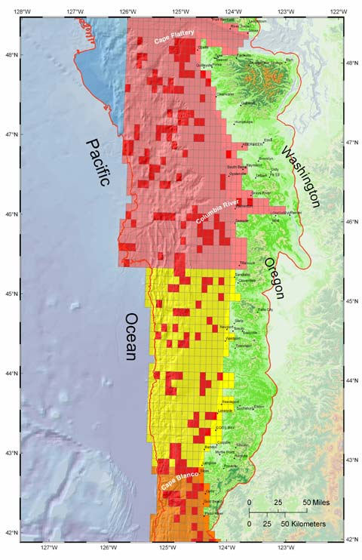
4. Modeling of climate change impacts on coastal fishery
Spatial framework
Existing spatially integrated fisheries’ bio-economic models (ISIS-Fish, ECOSPACE of Ecopath with Ecosim)
ISIS-Fish (Bay of Biscay, France)
ECOSPACE (EwE) (N. California, U.S.A.)

Slide 7
4. Modeling of climate change impacts on coastal fishery
Spatially integrated models
Used primarily to assess management regulations (e.g. establishment of MPA’s) - Assessment of CC impacts on fishery resource.
Regional calibrated versions of EwE: North Sea (developed), Baltic (under development, in the context of ‘MARE’).
Assessment of models’ spatial framework.
Aims/Objectives:
Application of model on a ‘coastal’ scale
How can the spatial resolution of the models be improved?
Interactions between the models’ grid cells (How do the values of one cell define the respective values of neighboring cells?)
Notes:
ISIS Fish and Baltic Cod: Work by Kraus and Pelletier (2008)
MARE – Marine Research on Eutrophication Program

Slide 8
Thank you!
Notes:
ISIS Fish and Baltic Cod: Work by Kraus and Pelletier (2008)
MARE – Marine Research on Eutrophication Program

