Slide 1
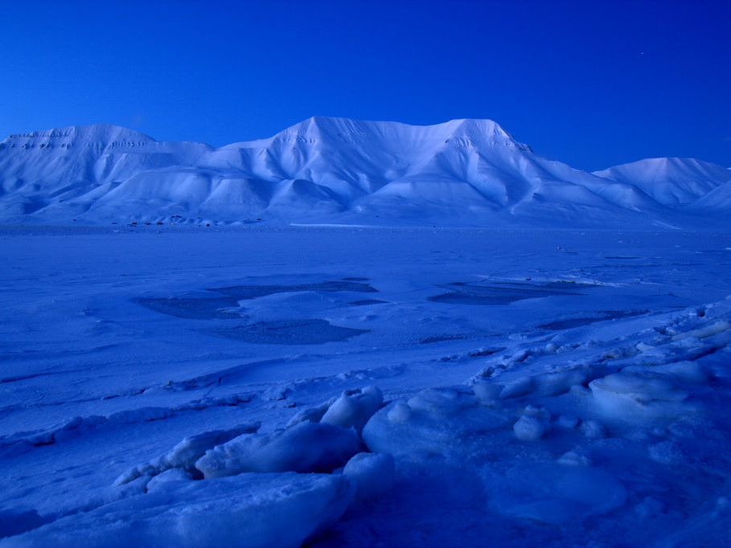


The photochemical transformation of organic matter in sea ice and its impact on the functioning of the sea ice ecosystem.
Susann Haase
University of Helsinki, Finland
Supervisors: Anssi Vähätalo (University of Helsinki)
Mats Granskog (Norsk Polar Institute in Tromsö)

Slide 2

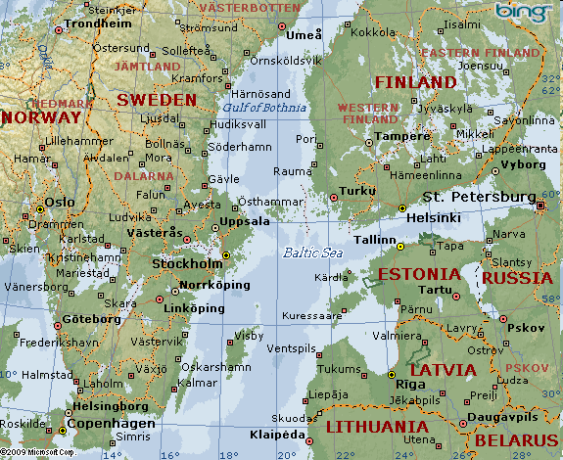
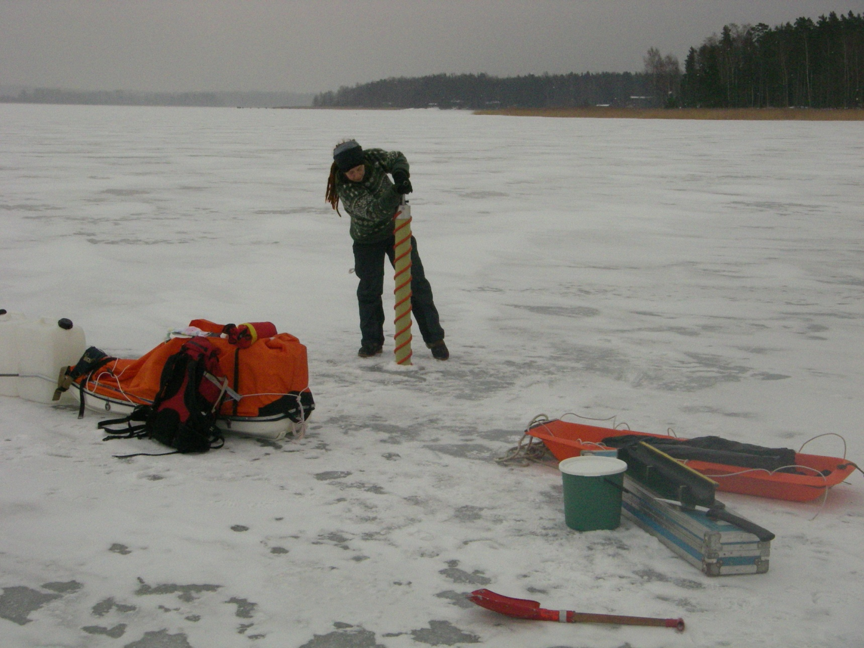
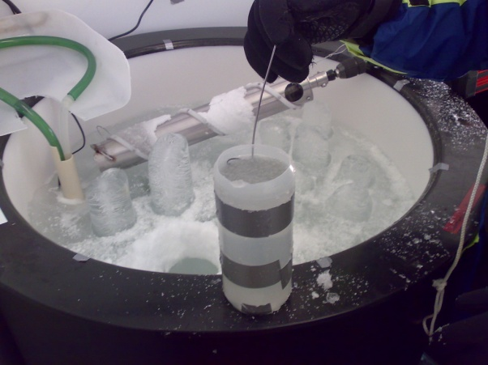
Susann Haase, University of Helsinki
Field work on the Baltic Sea, February 2009, Santalla
Sea Ice in the
Baltic Sea
DOM
introduction
Methods
Results and
plans

Slide 3
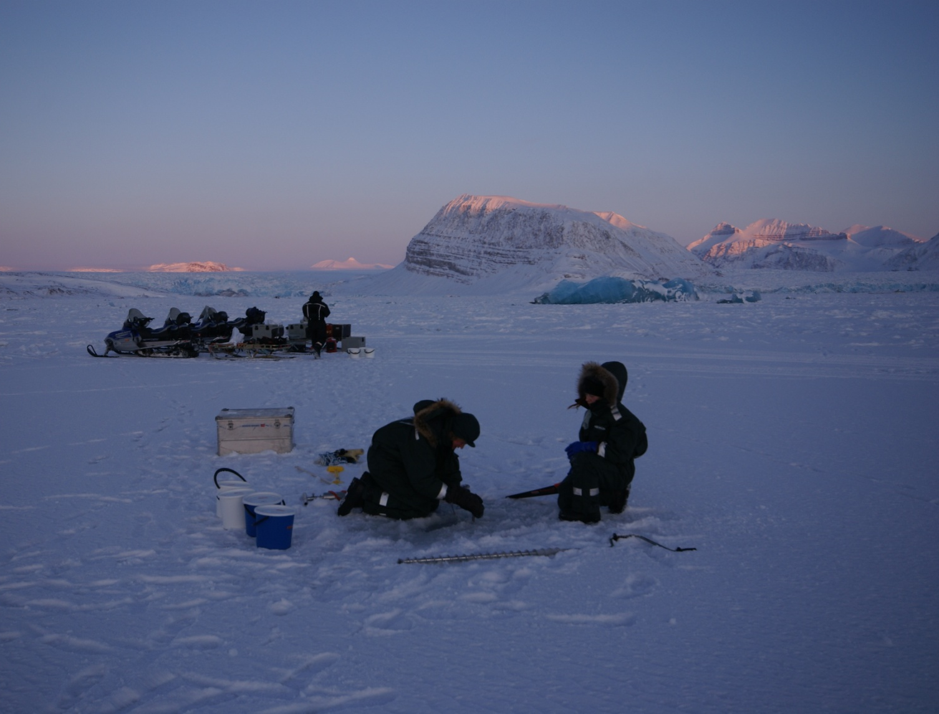
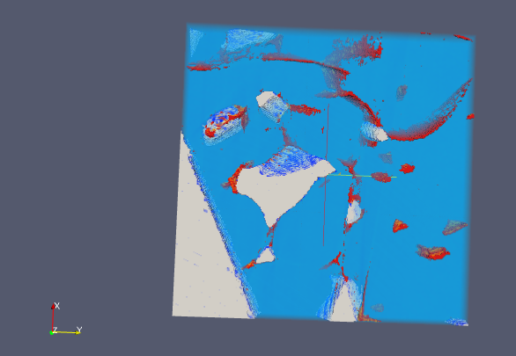
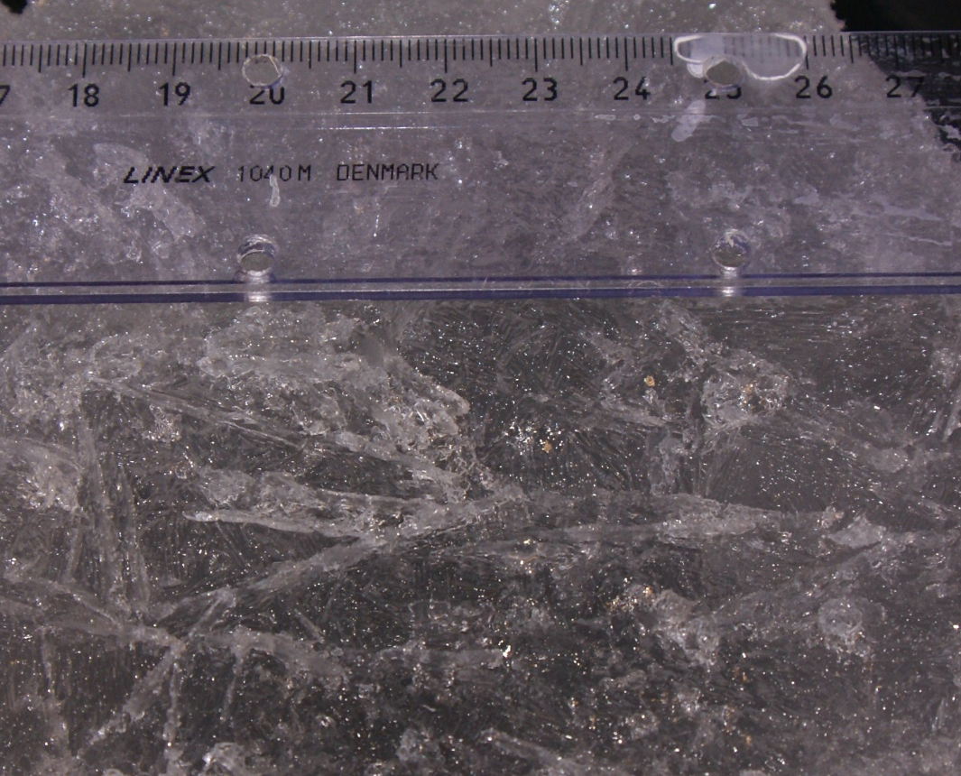
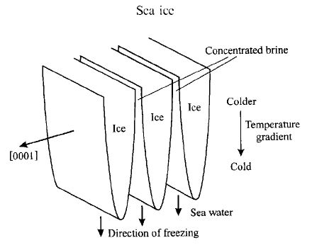
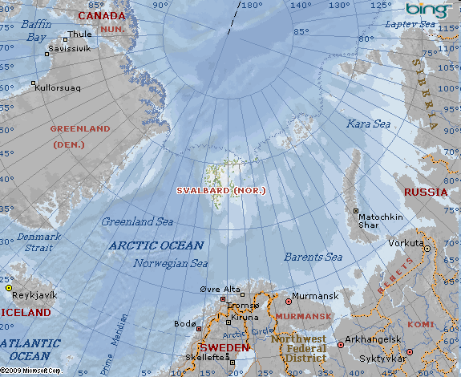
Susann Haase, University of Helsinki
Field work on Svalbard (Norway), March 2009
Sea Ice in the
Baltic Sea
DOM
introduction
Methods
Petrenko and Whitworth (1999)
Results and
plans

Slide 4
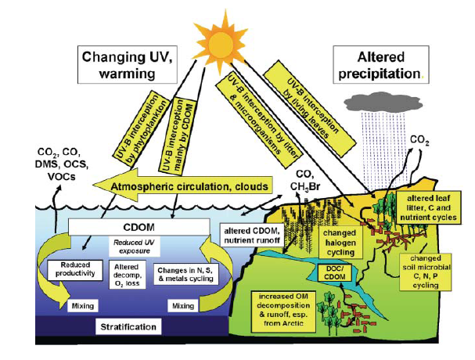
Susann Haase, University of Helsinki
Biochemical cycles
Sea Ice in the
Baltic Sea
DOM
introduction
SEA ICE
Methods
Results and
plans
Zepp et.al (2007)

Slide 5
Susann Haase, University of Helsinki
Chromophoric dissolved organic matter (CDOM):
Sea Ice in the
Baltic Sea
complex mixture of organic material
- dissolved (< 0.45µm)
- absorbing light
- microbial – and photodegradation
DOM
introduction
- heterotrophic food web
In Sea Ice:
What happens to DOM during the freezing process?
Entraped or expelled?
➔ Not much known about DOM in sea ice!
Methods
How much DOM is in the ice (abiotic condition)?
What happens to the DOM in the ice during aging?
Results and
plans

Slide 6
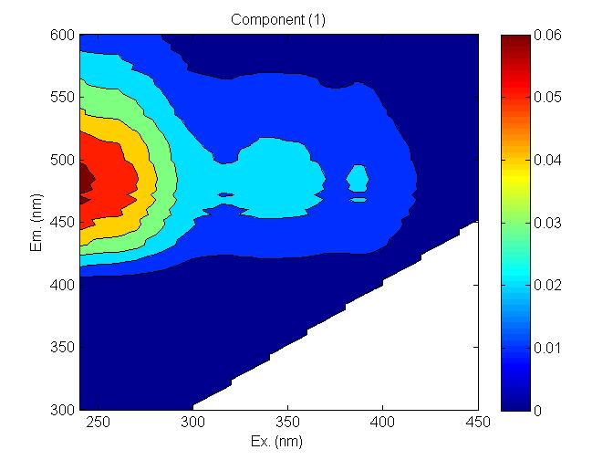
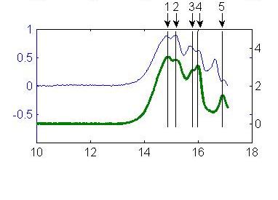
Susann Haase, University of Helsinki
Behaviour of DOM during freeze fractionation
Sea Ice in the
Baltic Sea
CDOM: absorption spectra
Quantity of DOM
Quality (spectral slope)
DOM
introduction
FDOM: fluorescent DOM
➔3-dimensional plots (EEMs)
➔characteristic components
Molecular size distribution (LC-SEC)
➔ Quality of DOM
Methods
Results and
plans

Slide 7
Susann Haase, University of Helsinki
Freeze fractionation in baltic sea ice
Sea Ice in the
Baltic Sea
-4 tanks (360 liters, Gulf of Finland)
-natural ice from coastal area (2007 + 2008)
➔ salt and DOM is excluded from ice
DOM
introduction
BUT: DOM less than salt
Size dependent separation
diffusion/drainage
accumulation
Methods
-Increasing effect with aging
Results and
plans
Salt + particles
+ DOM

Slide 8
Susann Haase, University of Helsinki
Further plans
Sea Ice in the
Baltic Sea
Experiments with more chemical and
biological parameters
-Impact of ice cover on ecosystem
Correlation of DOM and pore size
Degradation by biological activity and UV-light
DOM
introduction
Methods
Thank you ☺
Results and
plans

