Slide 1
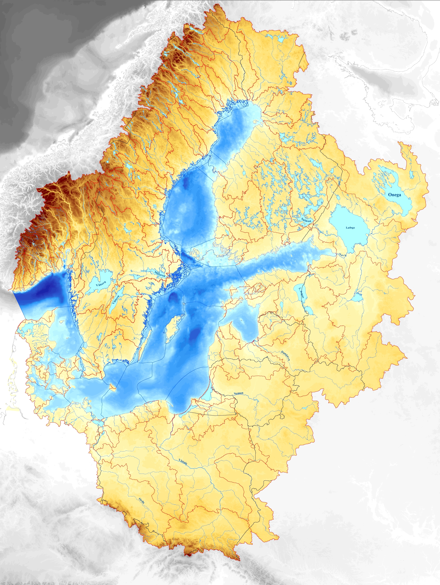

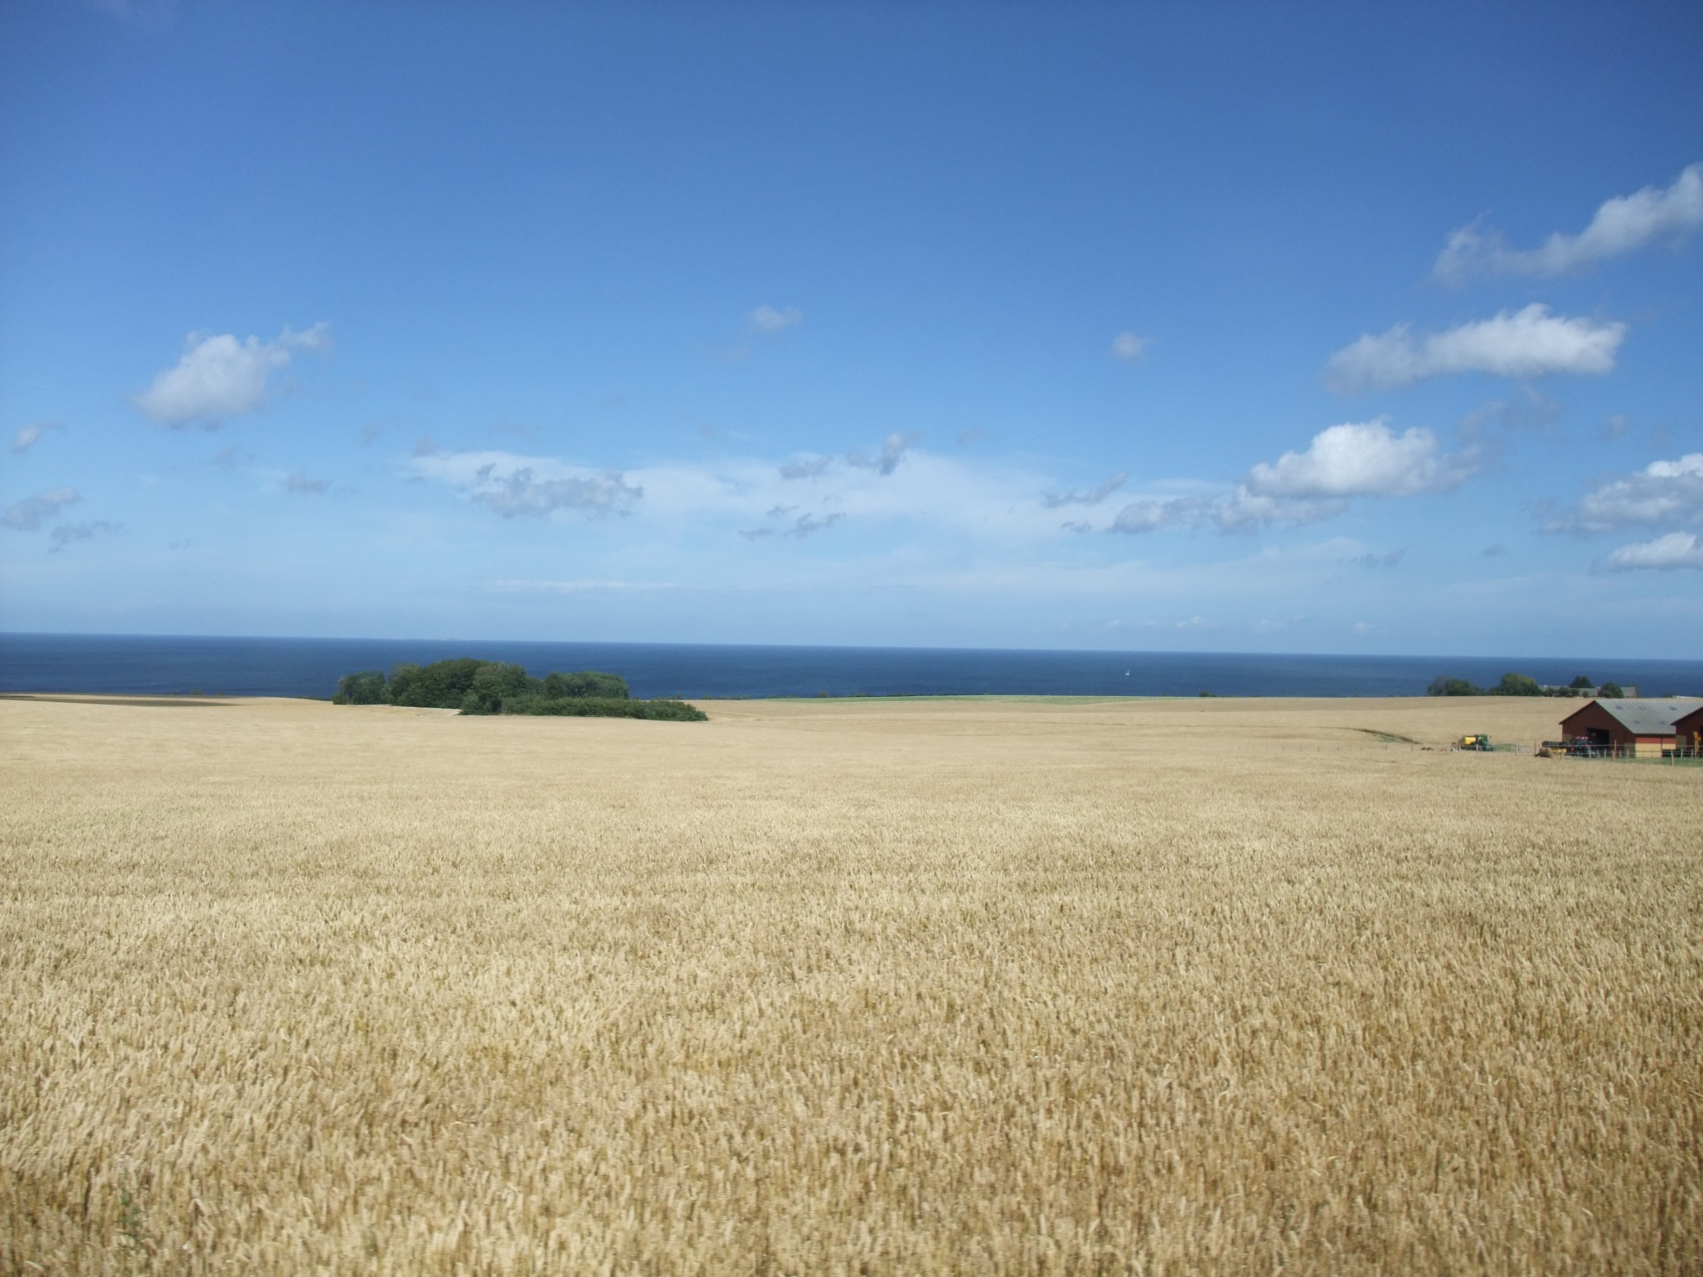
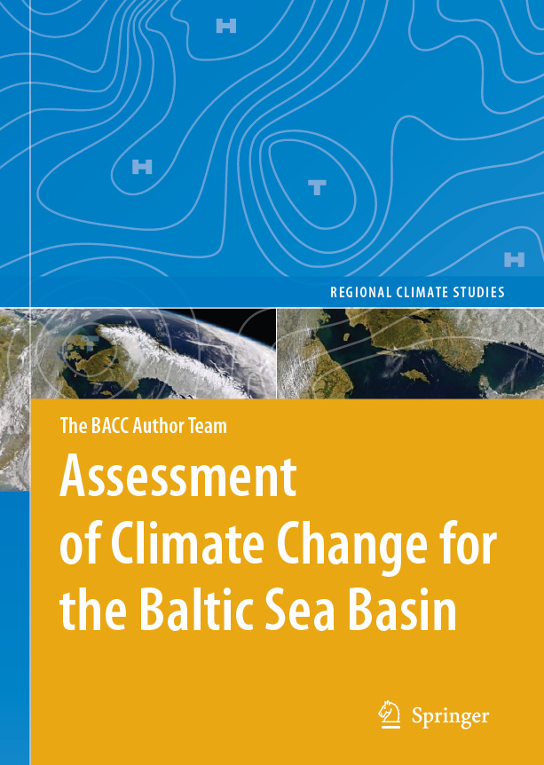
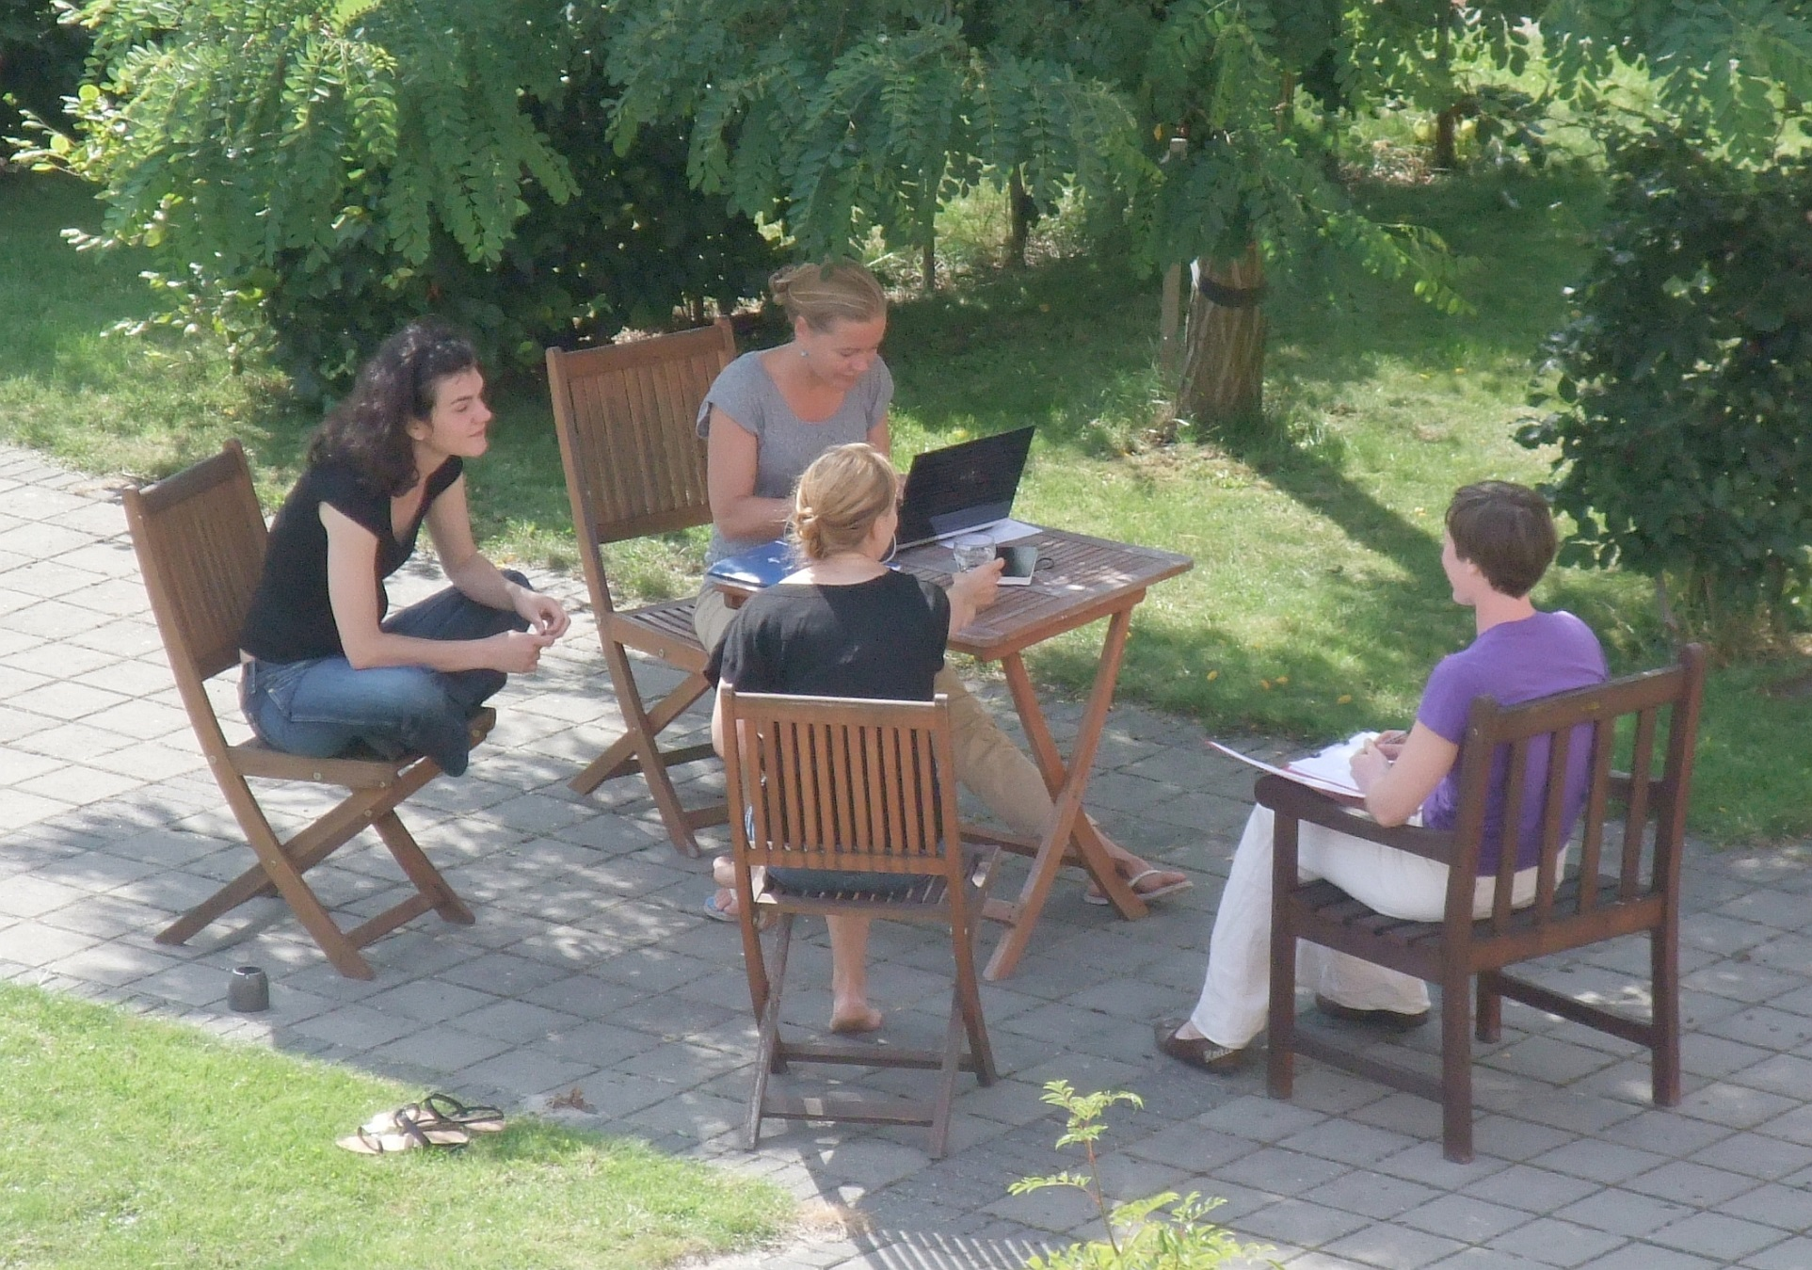

The International Baltic Earth Secretariat (IBES) is located at Helmholtz-Zentrum Geesthacht (Germany) as a focal support point for Baltic Earth.
More information on Baltic Earth and BALTEX is available at www.baltic-earth.eu
Baltic Earth
Earth System Science for the Baltic Sea Region
An open research network to achieve an improved
Earth system understanding of the Baltic Sea region
Baltic Earth
succeeds BALTEX
Extending the knowledge of the regional Earth system in the Baltic Sea region
The goal of Baltic Earth is to achieve an improved Earth system understanding of the Baltic Sea region.
Baltic Earth is the successor to BALTEX that was terminated in June 2013 after 20 years and two
successful phases. The research components of BALTEX continue to be relevant, but now have a more
holistic focus encompassing processes in the atmosphere, on land and in the sea, as well as processes
and impacts related to the anthroposphere. Specific interdisciplinary research challenges have been
formulated by the Baltic Earth Interim Science Steering Group to be approached by the new
programme in the coming years. The continuity in basic research fields, structure (secretariat,
conferences, publications) and the international network (people and institutions) is symbolized
by the logo, which is similar but still distinctly different from the BALTEX logo.
A major means of achieving the goals of Baltic Earth will be scientific assessments of particular research topics to be prepared by expert groups. Similar to the BACC approach, the assessments shall help to identify gaps and inconsistencies in the current knowledge. A Baltic Earth Science Plan will be established by the end of 2014, with a definition of core research questions, so-called “Grand Challenges”. They are currently:
Salinity dynamics in the Baltic Sea
Land-Sea biogeochemical feedbacks in the Baltic Sea region
Natural hazards and extreme events in the Baltic Sea region
Understanding sea level dynamics in the Baltic Sea
Understanding regional variability of water and energy exchanges
The Grand Challenges are intended as flexible, regularly updated research topics and will be dealt
with by specific working groups. In addition, the BALTEX Working Groups on the “Utility of Regional
Climate Models”, and “Assessment of Scenario Simulations for the Baltic Sea 1960-2100 “ will continue
in Baltic Earth. Dedicated working groups have also been established on “Outreach and Communication” and “Education”.
The human impact shall be assessed at all levels, wherever possible and reasonable. New Grand Challenges and modifications of existing ones can be implemented by the steering committee and the working groups, by using the assessments of existing research and knowledge, and the open discussions at conferences and workshops. The Grand Challenges are foreseen as research foci for periods of about 3-4 years (then terminated or updated). It is envisaged that Baltic Earth will be internationally embedded in a similar manner as was BALTEX.
Baltic Earth intends to provide a “service to society” in the respect that the assessments may provide an overview of knowledge gaps, and the communication with different stakeholders may help to identify open scientific questions relevant for society, which could be approached by funded research projects.
Baltic Earth will also be committed to educational activities with the establish-
ment of regular Baltic Earth Summer Schools, the first of which is intended to
take place in 2015. The first dedicated Baltic Earth Conference is planned for 2016.
Image provided by the SeaWiFS Project,NASA/Goddard Space Flight Center and ORBIMAGE.
Assessment projects similar to BACC will be concrete outcomes of Baltic Earth
“Products” of Baltic Earth will include: → Conferences
                Workshops
                Assessment Projects
                Research Projects
                Summer Schools
The Baltic Earth Science Steering Group (as of June2014): Markus Meier (Chair), Anna Rutgersson (Vice-Chair), Juris Aigars, Franz Berger, Inga Dailidienė,
Chantal Donnelly, Jari Haapala, Sirje Keevallik, Karol Kulinski, Andreas Lehmann, Kai Myrberg, Carin Nilsson, Anders Omstedt, Irina Partasenok, Piia Post,
Marcus Reckermann, Gregor Rehder, Benjamin Smith, Martin Stendel, Hans von Storch, Sergey Zhuravlev, Eduardo Zorita

